Slide 1
How to Reconcile Citicard
For this presentation TA = Travel Authorization (the first step of the process when you Asked to use funds)

Slide 2
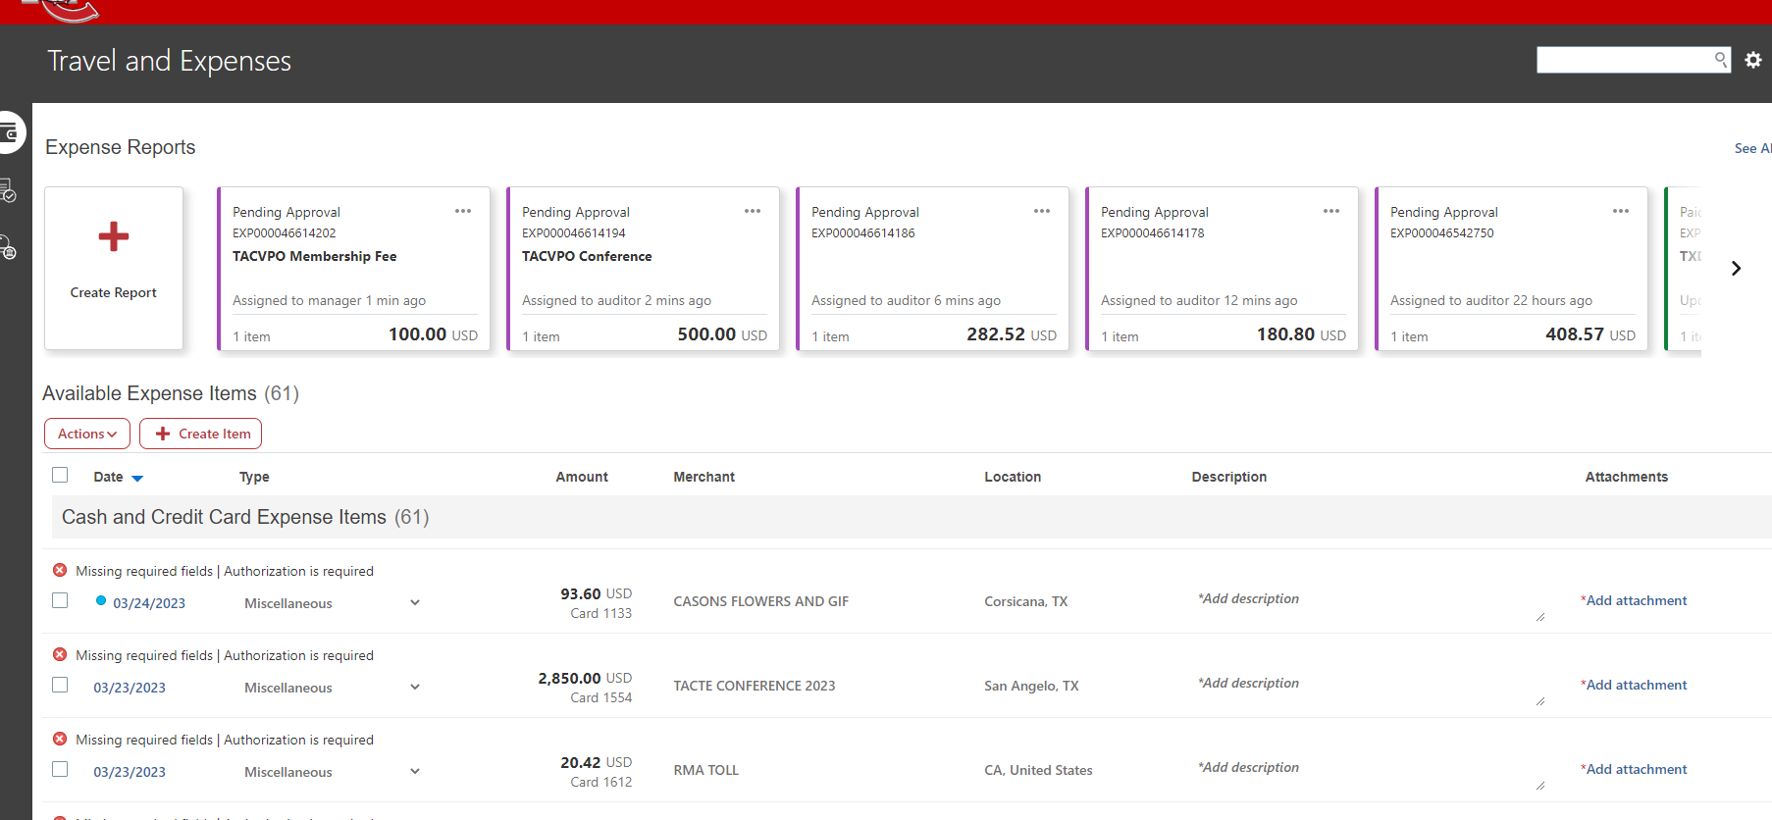
Step #1 All Credit charges show in this space – You can reconcile at anytime
(you do not have to wait or worry about statements anymore).
Step #2 –
Click on the blue date hyperlink
Step #3 –
The type is always marked miscellaneous .. You MUST change this to match your TA
( request to use funds)

Slide 3
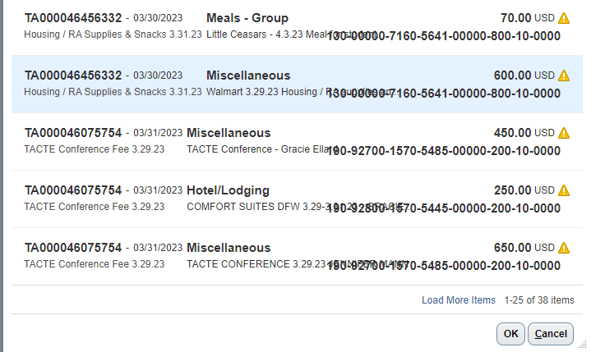
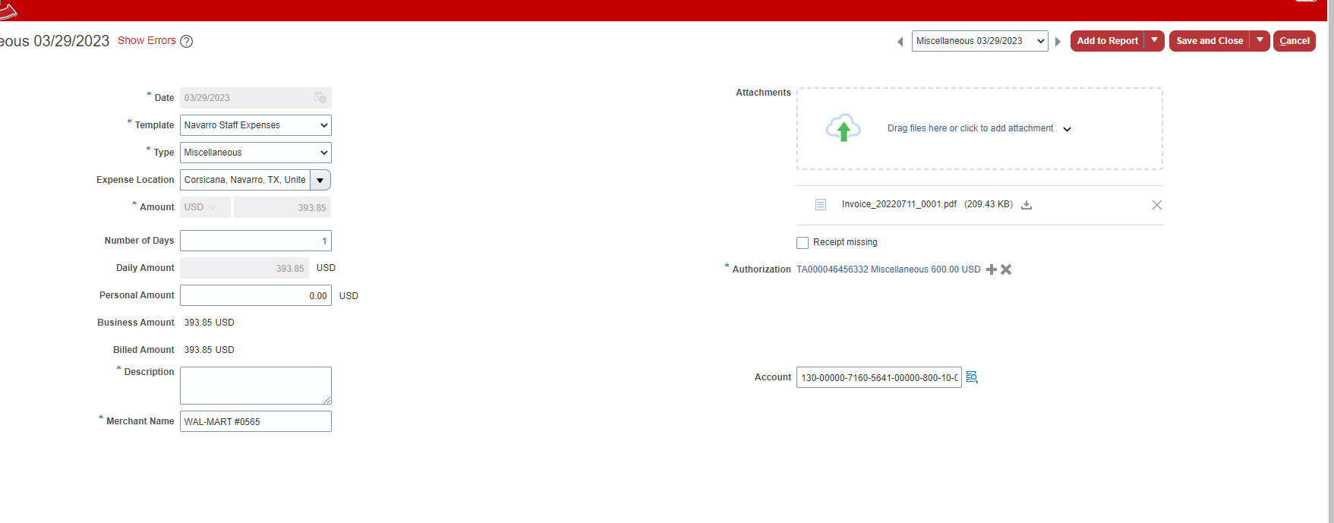
Step #4 – fill in the mandatory * boxes.. And any others you want to do beyond the mandatory.
NOTE: Description – you can copy and paste from your TA
Template – Type – Needs to match the TA
Step #5 - Attach your receipts (ex. Hotel Bills, Meal Receipts, Registration, etc.. ) Mandatroy
Step #6 – VIP step. This is how you link your TA to the EXP(ense)
Step #7 - Click the Authorization Line (turn the line blue)
Step #8 – Click OK
Step #9 – Change GL act to match TA
Step #10 – Click Add to Report
FYI:
Generic Cards / Dept Card Holders - Travel and Non Travel dynamic form will be online at MyNC – Staff Forms
Eta 4/7/23
HINT: I have found it easier to write down each TA number with the description.
And the amount on the pop up is what you ASKED for on the TA
.

Slide 4
Step #11 – look for errors
if you have an error click on the date hyperlink again and look for a red box - or Did you link your Authorization TA?
Step #12 – Submit
On your TA Screen (snowglobe) if you did all the lines for that TA
it will show Applied to 1 report

Slide 5
Multiple Lines on one TA
Complete Steps #1 – 11 DON’T Submit
Step #12 Click ADD EXISTING

Slide 6
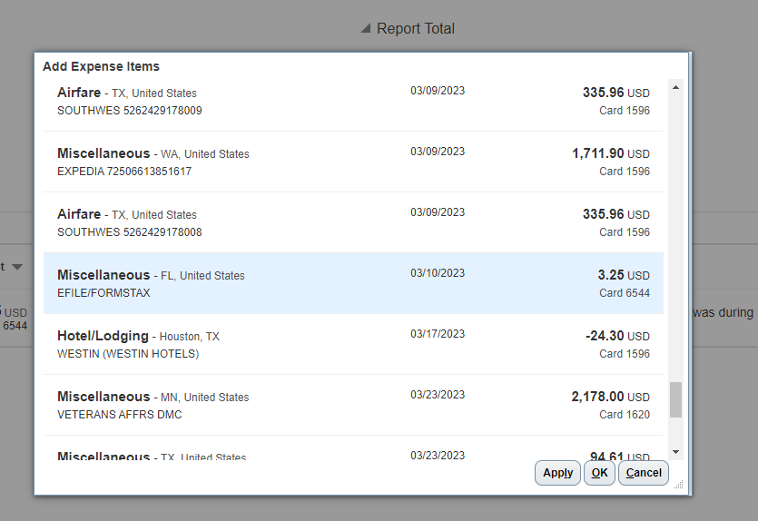
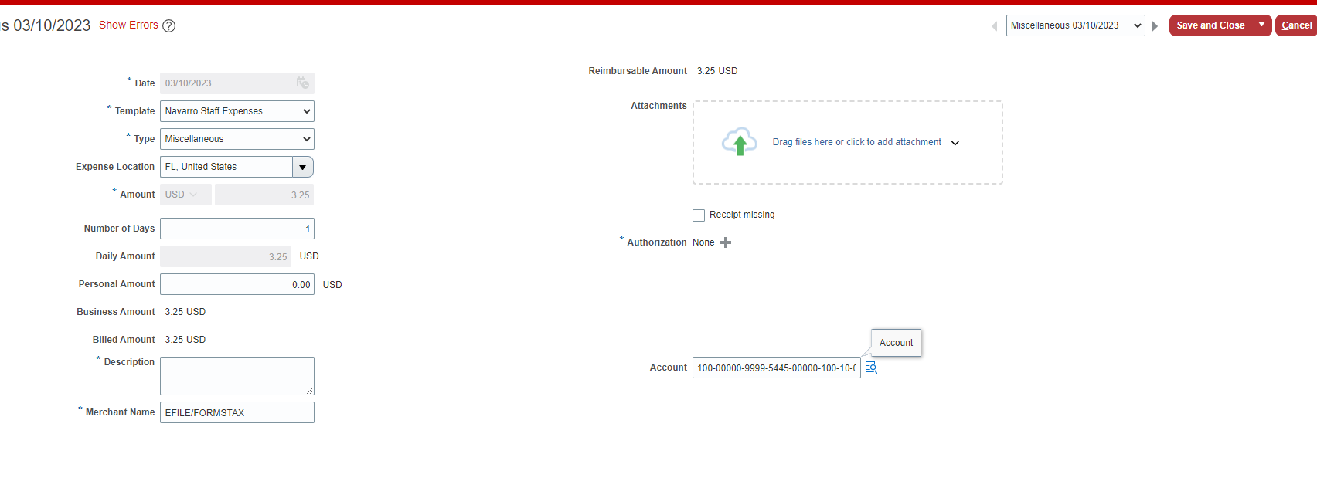
Step #13 – Pop Up Opens
Click the next charge you want to attach to the same TA
Step #14 / # 15 – Click Apply - OK
Step #16 – You WILL receive an error – click the blue date hyperlink and open the new line
REPEAT STEPS #4- #9
Step #10 = Save & Close

Slide 7
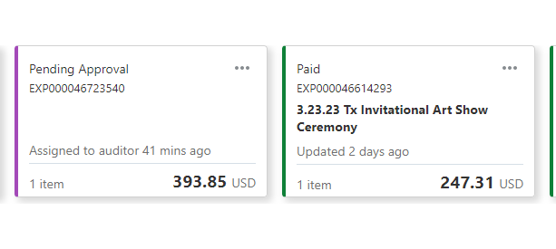
Step #11 - Purpose – Be sure to put the purpose in..
Step #12 – Submit
Pic on left NO Purpose ..
Pic on right Purpose - 3.23.23 Tx Invitational Art Show Ceremony

Slide 8
Shows we paid Citicard
$8.00

Slide 9
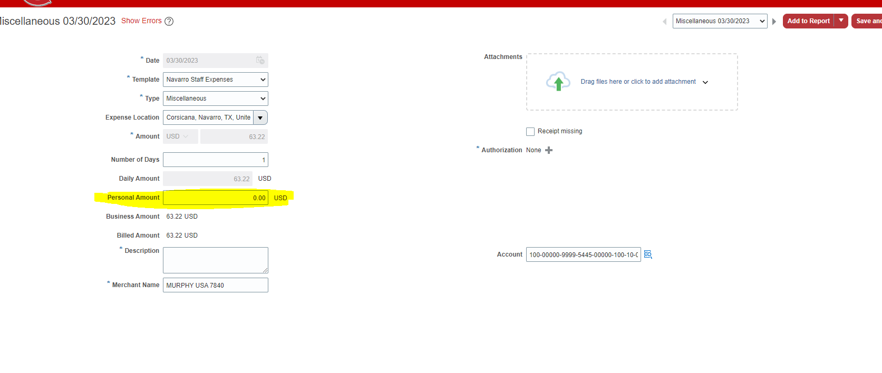
TA with a Mix of Citi card and Personal Funds
As you are adding the lines in – if you are owed the funds and NOT citicard you will put the total amount in the personal amount area. This is the only step that is different.

Slide 10
If you are owed personal funds it will show here how much went to Citicard and how much went to you.

